Slide 1

web development via e learning
Prepared By:
Aman Prasad (186380307038)
Dhruv Itwala (186380307010)
Siddhi Patel (186380307036)
Harsh Bhatiya (186380307002)
Guided By:
Kajol Patel
PIET- DS(CE)

Slide 2
Outlines
Abstract
Introduction
Scope of System
Existing System
Proposed System
Tools & Technology
Advantages & Disadvantages

Slide 3
Outlines
Data Dictionary
E-R Diagram
Use Case Diagram
Activity Diagram
System Flow Diagram
Class Diagram
Implementation

Slide 4
Outlines
Conclusion
Future Scope
Bibliography

Slide 5
Abstract
A learning system based on formalized teaching but with the help of electronic resources is known as E-learning. Immersive learning experience on an electronic device, perfectly simulated for students and to encourage learning. The learner can learn different frontend technologies like PHP, HTML5, CSS with database connectivity, certification course that too free of cost and learn how to host their website .

Slide 6
Introduction
Our website is an online education platform that provides the education regarding web development, it also teaches how to make your own website by creating your own templates. Our website provide free templates. We'll teach you from basic to advance. Our course is divided into six phases.
Phase 1 - html (basic + advance)
Phase 2 - CSS (basic CSS uses)
Phase 3 - Advance CSS (external CSS uses)
Phase 4 - PHP (basic + advance)

Slide 7
Cont..
Phase 5 – MySQL (create your SQL database + how to insert data & access data)
Phase 6 – Hosting & Domain

Slide 8
Scope of System
Inbuilt online editor/compiler to perform code with learning Basic to Advance flow of course with detailed and easy understandable information step wise phases to learn the course.
Test after each core modules of each phases.
After completion of this course learner able to design website and host it.

Slide 9
Existing System
W3school :
W3 school is an online coding website that provides free coding knowledge
It provides short information , tutorials , references (but cannot warrant full correctness of all contents)
its free to use
It provides paid certificates.

Slide 10
Cont..
HOW OUR WEBSITE IS DIFFERENT FORM EXISTING SYSTEM
Our website is for specific Course i.e., Web development
Our website is free to use
Our website helps user to learn how to developed their own website from basic level to advance
We also provide free templates for Web development
We conduct Mock test after each phases.

Slide 11
Cont..
The user can go ahead only if his/her concepts are clear.
Our course is certified course, and we provide certificates
As our website is a certified Course so , the learner will receive a certificate after the completion of course which can be attached in resumes

Slide 12
Proposed System
Our website is free to use .
New users need to register.
Simple code explanation with simple illustrate how to used it.
Student can choose the phase as per their interest.
Tutorial start from basic level and move all the way up to professional reference.
By using our online editor, you can edit your code and execute your code.

Slide 13
Tools & Technology
Front End
Back End
HTML
CSS
PHP
MySQL

Slide 14
Advantages
Our website is free to use , anyone can access it from anywhere , and it is 24x7 available .
Our course is a certified course so one could have certificate after the completion of course.
We provide the information in easy and understandable language so one could easily get to know .
We conduct mock tests after each section and provide editor and compiler where they can code and clear their doubts , they can contact us any time for any query and we assure to give replay within 24 hrs...

Slide 15
Disadvantages
The user can cheat in quiz as we don't have any kind of anti-cheat system.
In Editor and compiler, the user must write code themselves as we don't provide the code (But they simply copy paste our explanation code and can have changes in it)
We don't provide compiler and editors for Database linking so for that they must install Xampp Server (Though we will teach them each and everything properly)

Slide 16
Cont..
The user need a good internet connection as our website is online.
If user knows the html and php and he wanted directly you learn Database portion the user must have to give all the mock test once and must score passing marks .

Slide 17
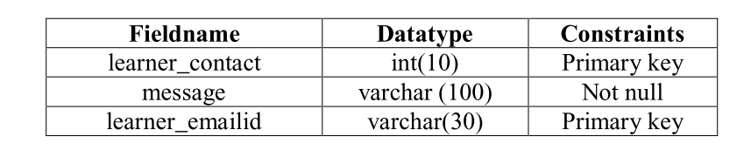
Data Dictionary
Table-1: Feedback

Slide 18
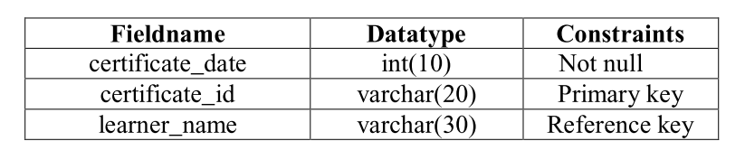
Cont..
Table-2 : Certificate

Slide 19
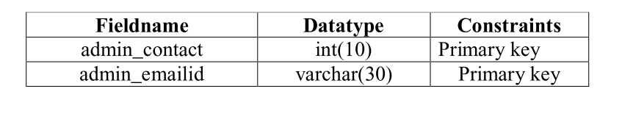
Cont..
Table-3: Contact Us

Slide 20
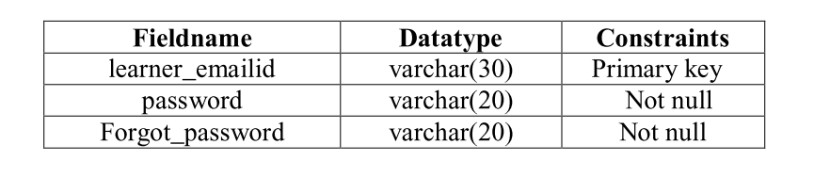
Cont..
Table-4: Login

Slide 21
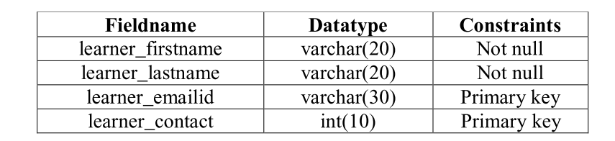
Cont..
Table-5: Signup

Slide 22
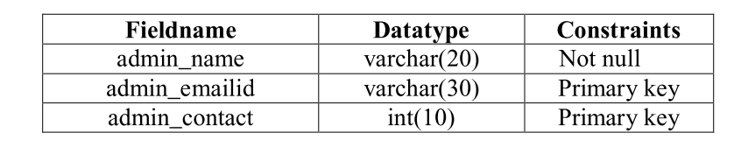
Cont..
Table-6: Admin

Slide 23
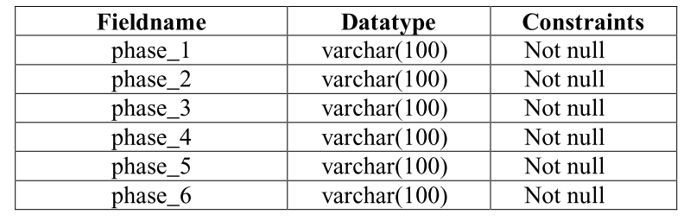
Cont..
Table-7: Courses

Slide 24
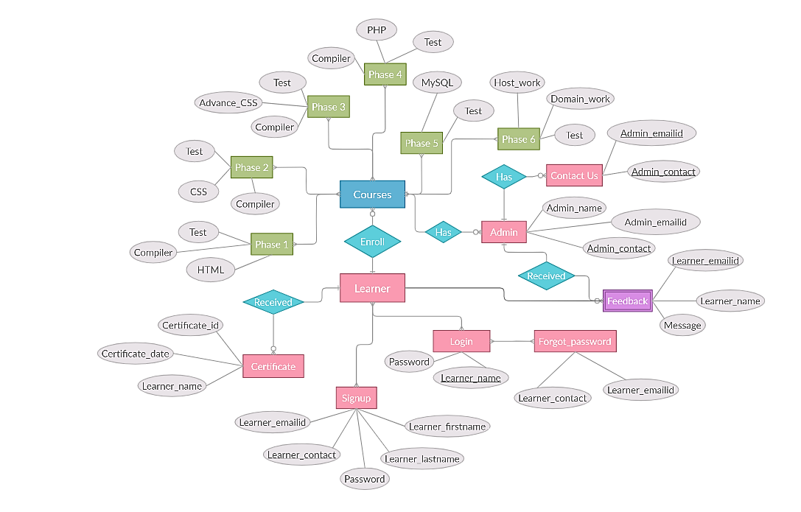
E-R Diagram

Slide 25
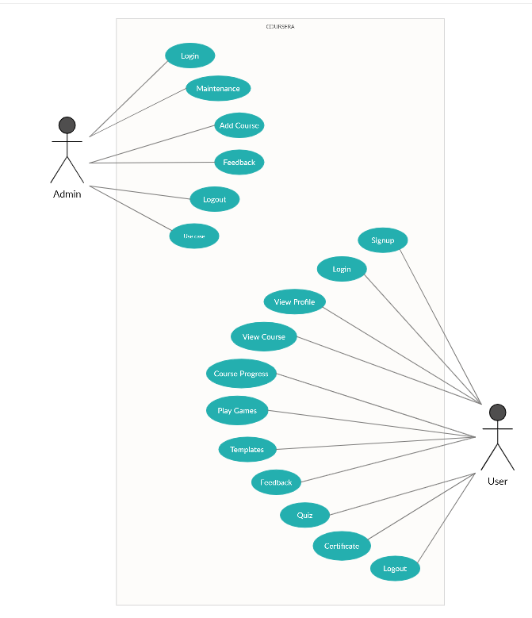
Use Case Diagram

Slide 26
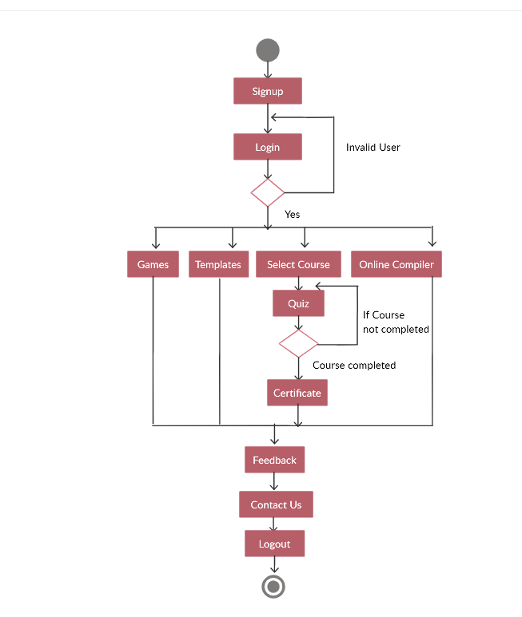
Activity Diagram

Slide 27
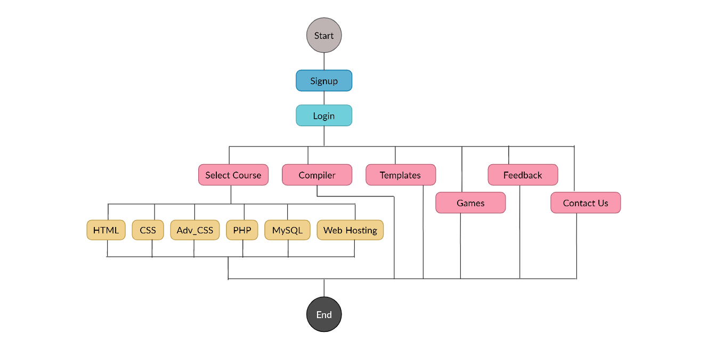
System Flow Diagram

Slide 28
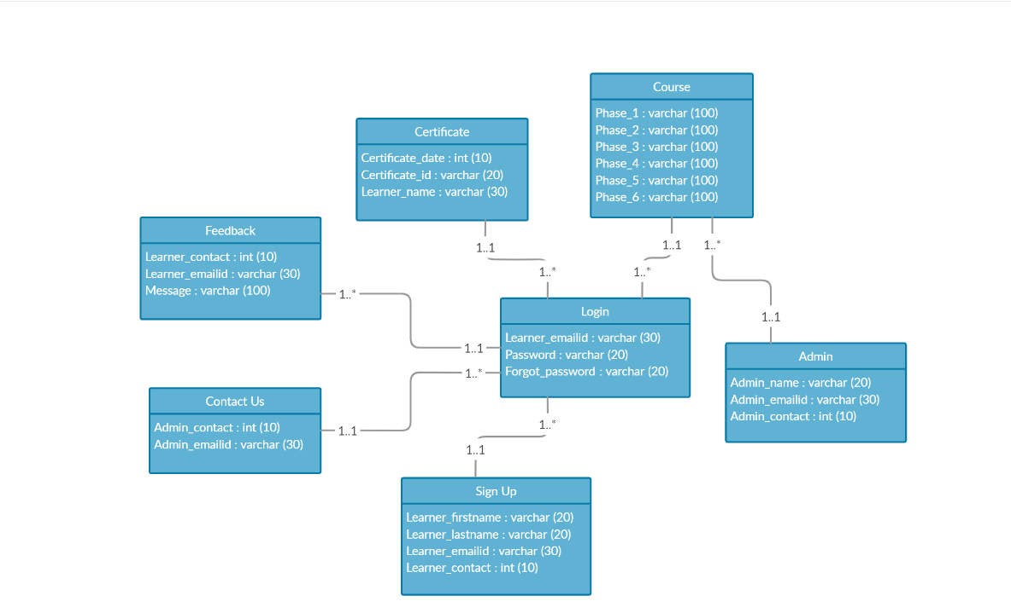
Class Diagram

Slide 29
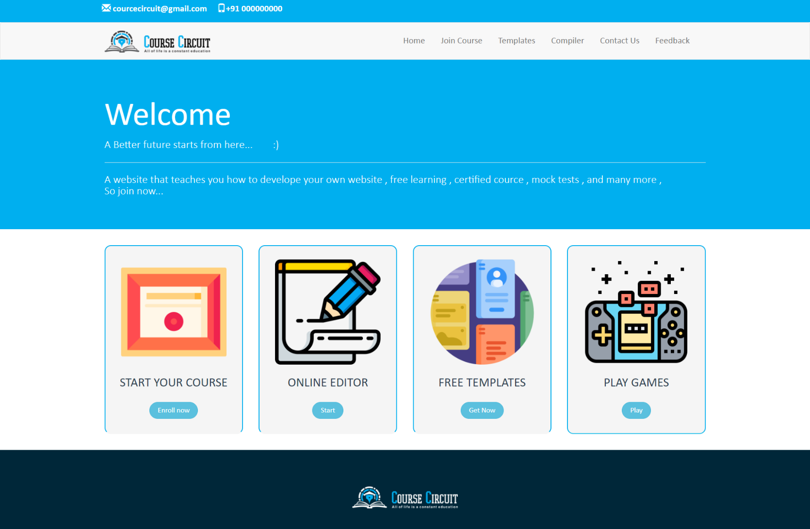
Implementation
Fig.1: Home Page

Slide 30
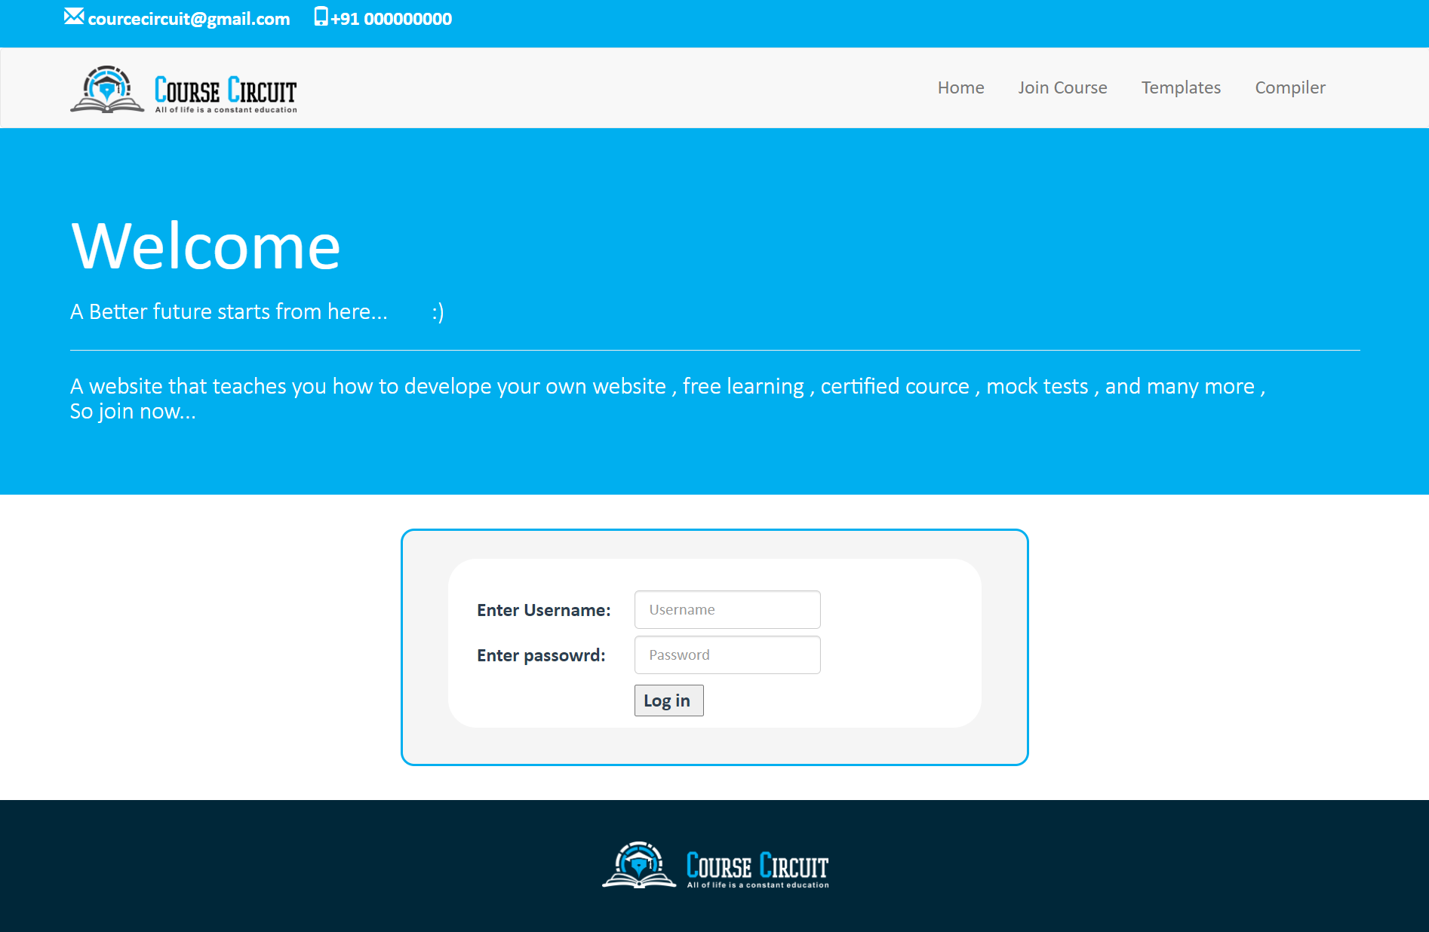
Cont..
Fig.2: Login

Slide 31
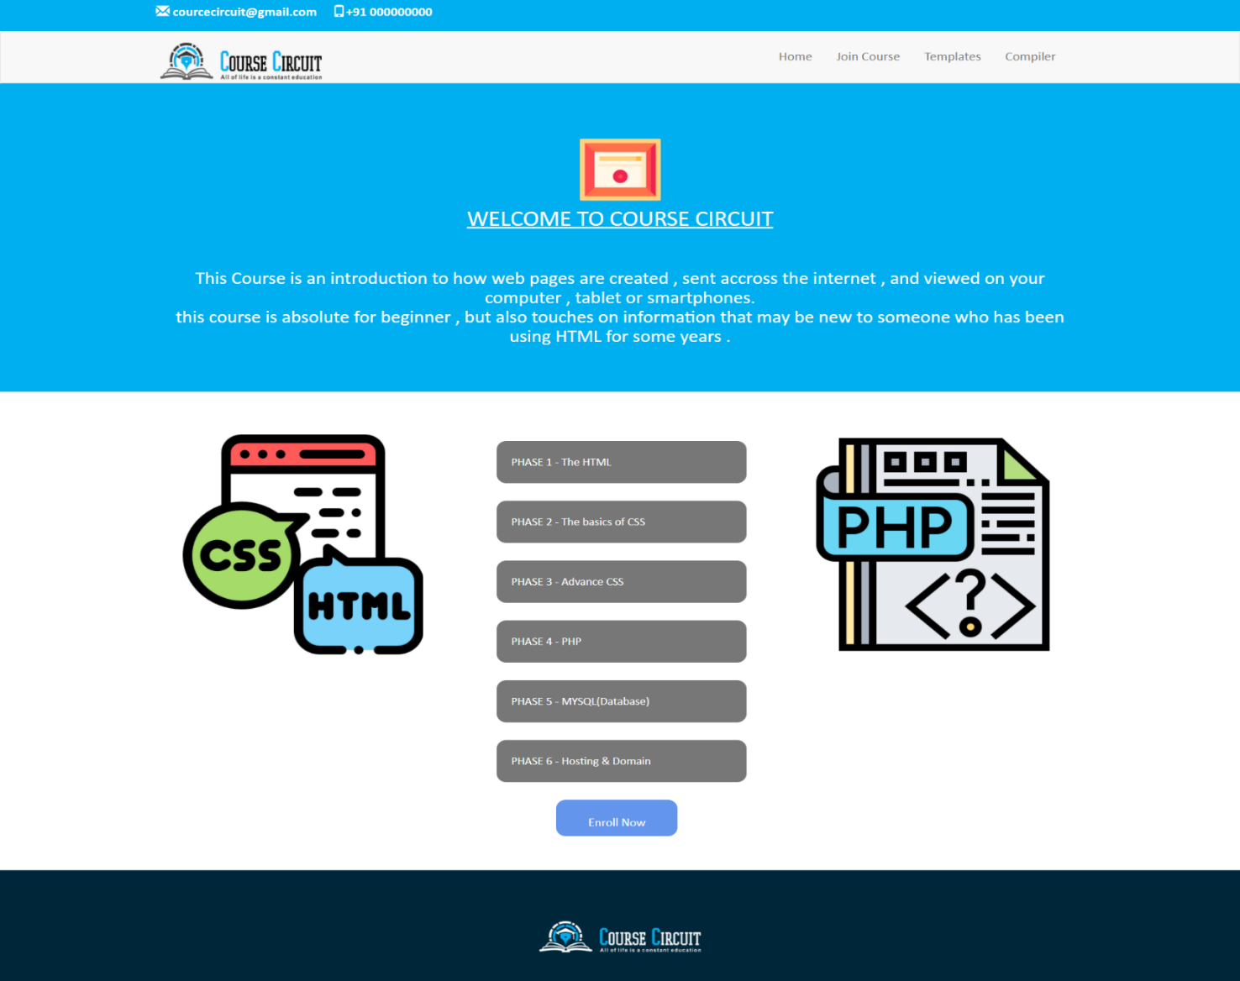
Cont..
Fig.3.1: Course Phases

Slide 32
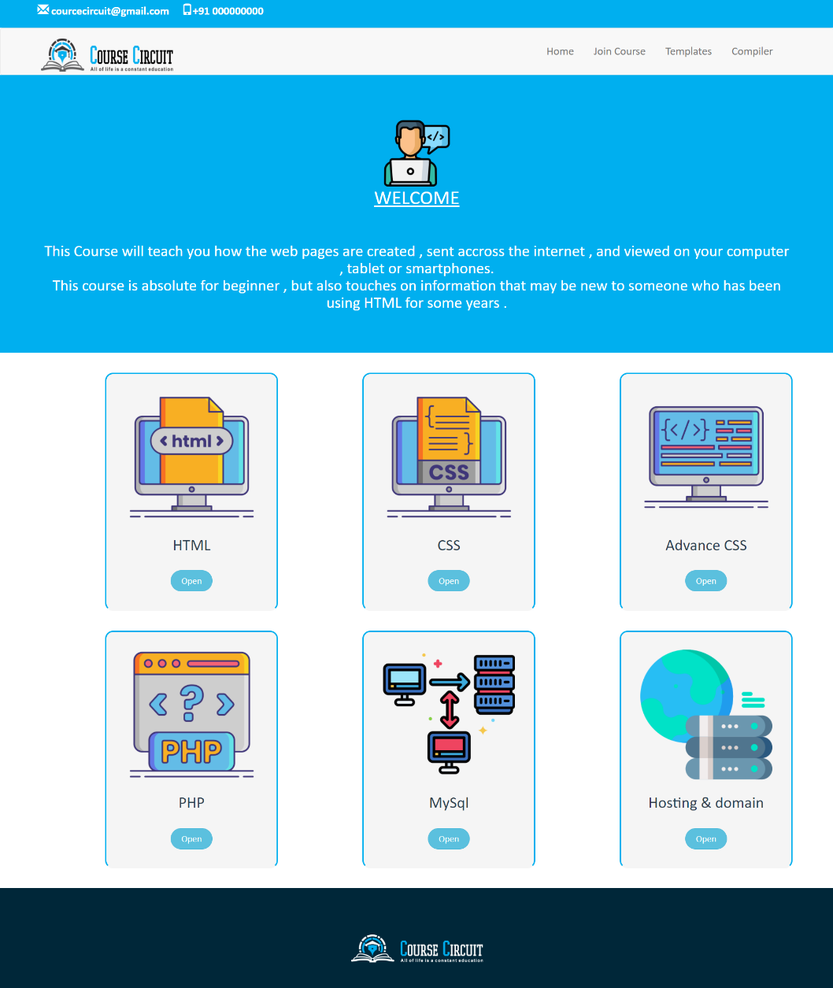
Cont..
Fig.3.2: Course Phases

Slide 33
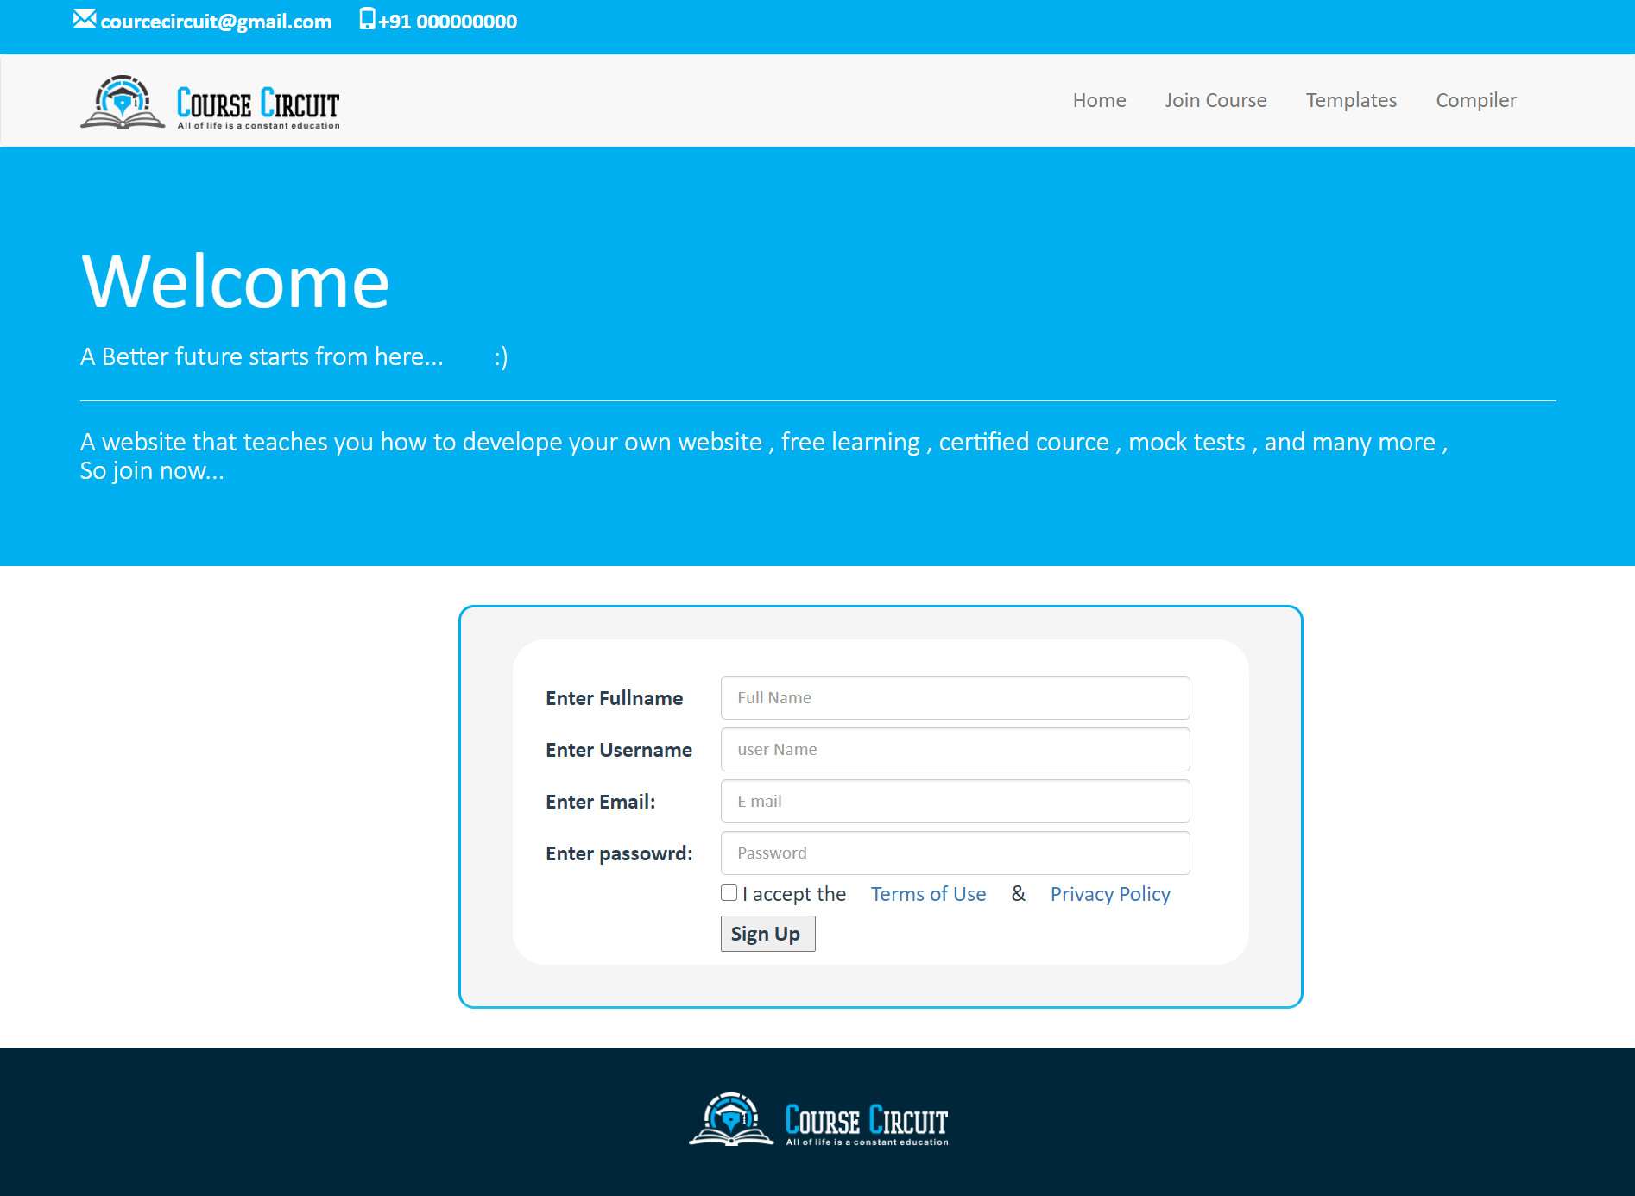
Cont..
Fig.4: Signup

Slide 34
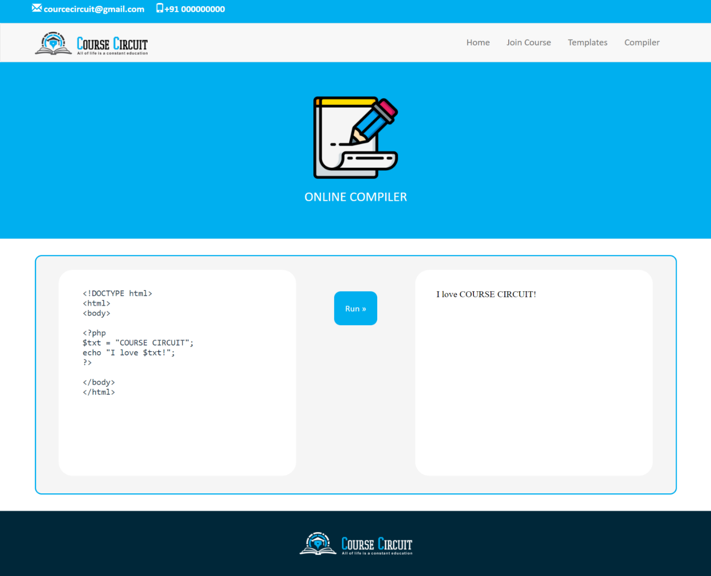
Cont..
Fig.5: Compiler

Slide 35
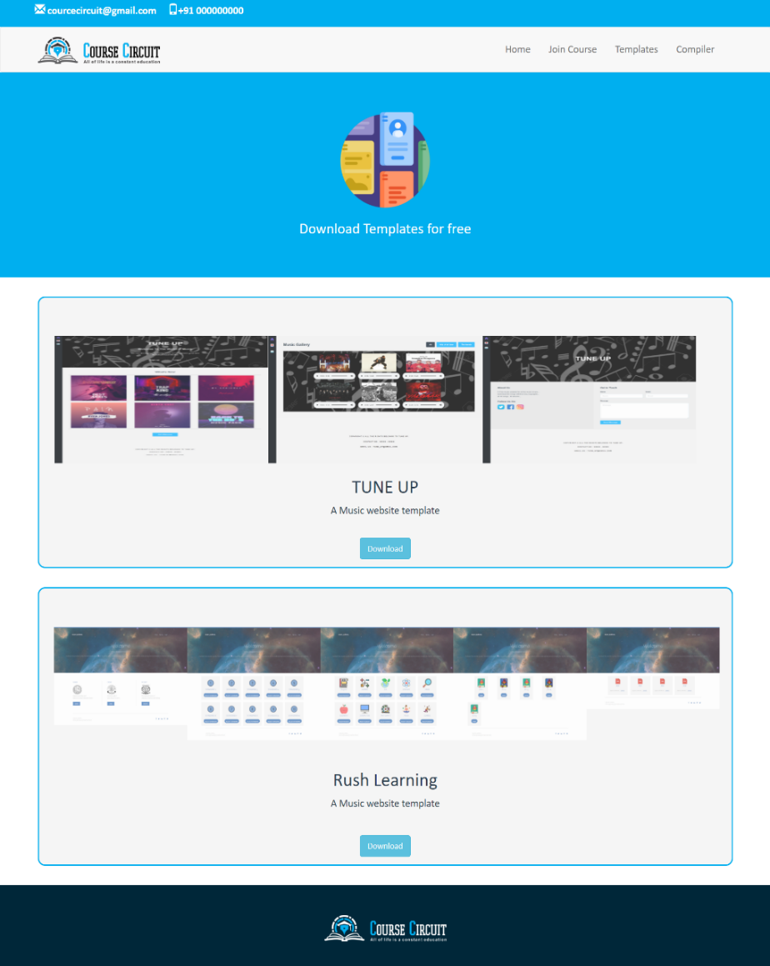
Cont..
Fig.6: Templates

Slide 36
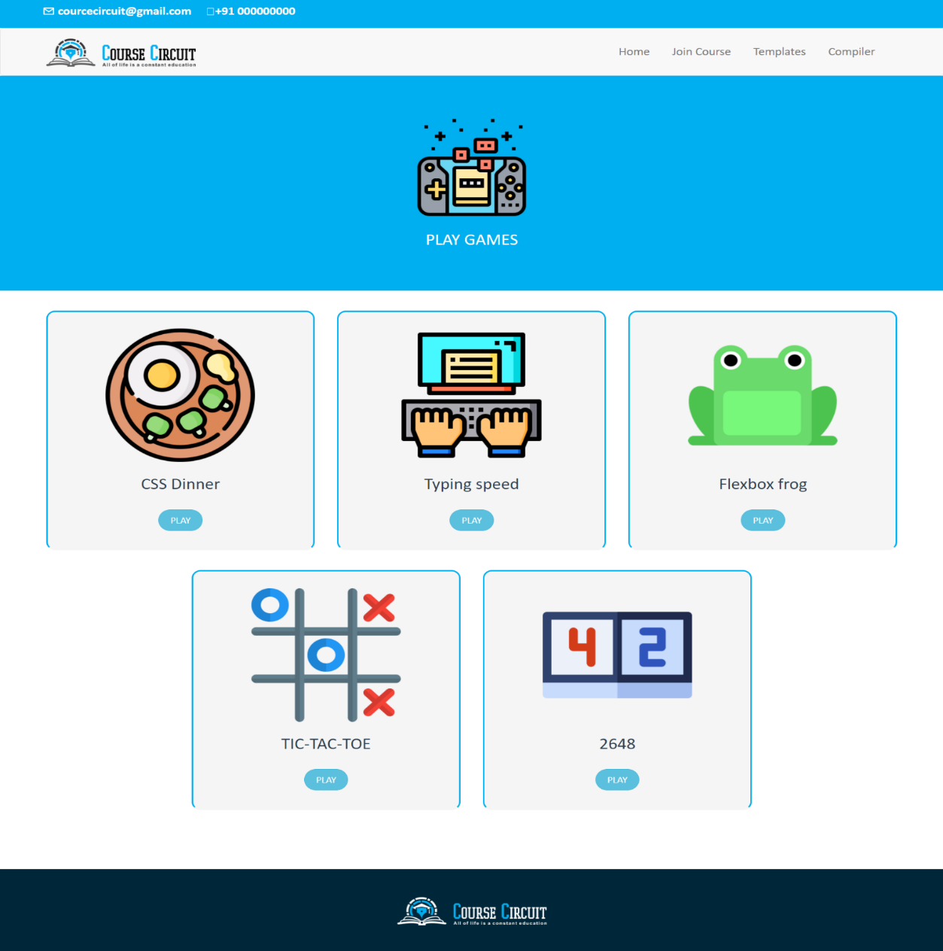
Cont..
Fig.7: Games

Slide 37
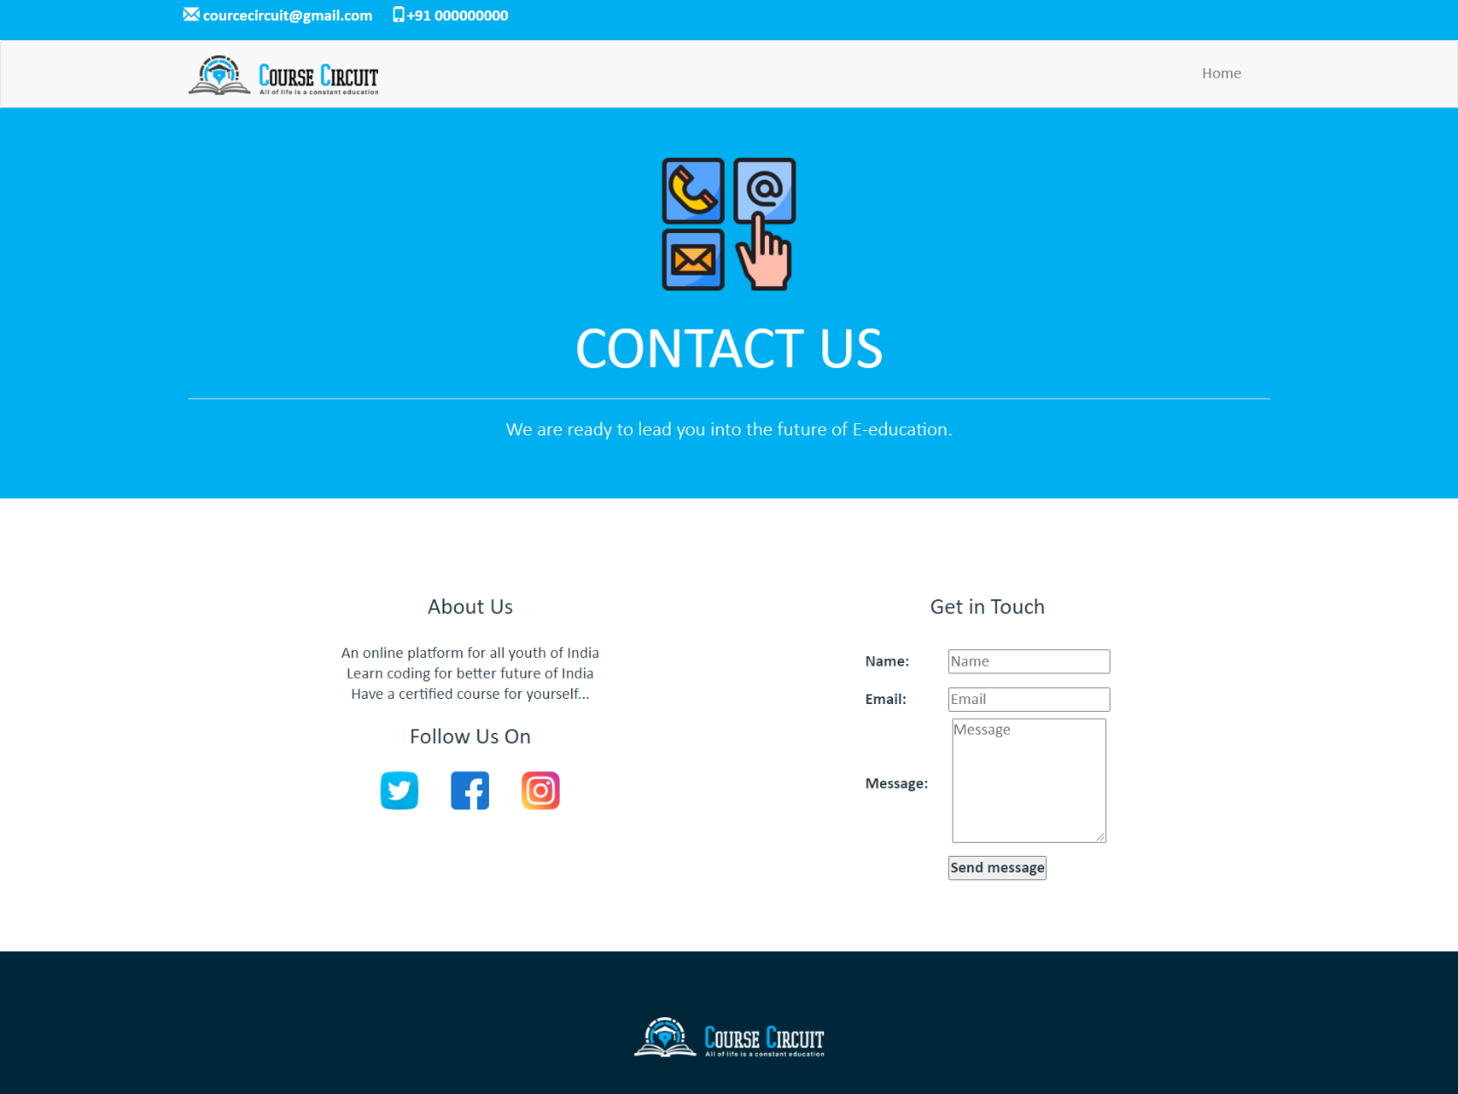
Cont..
Fig.8.1: Contact Us

Slide 38
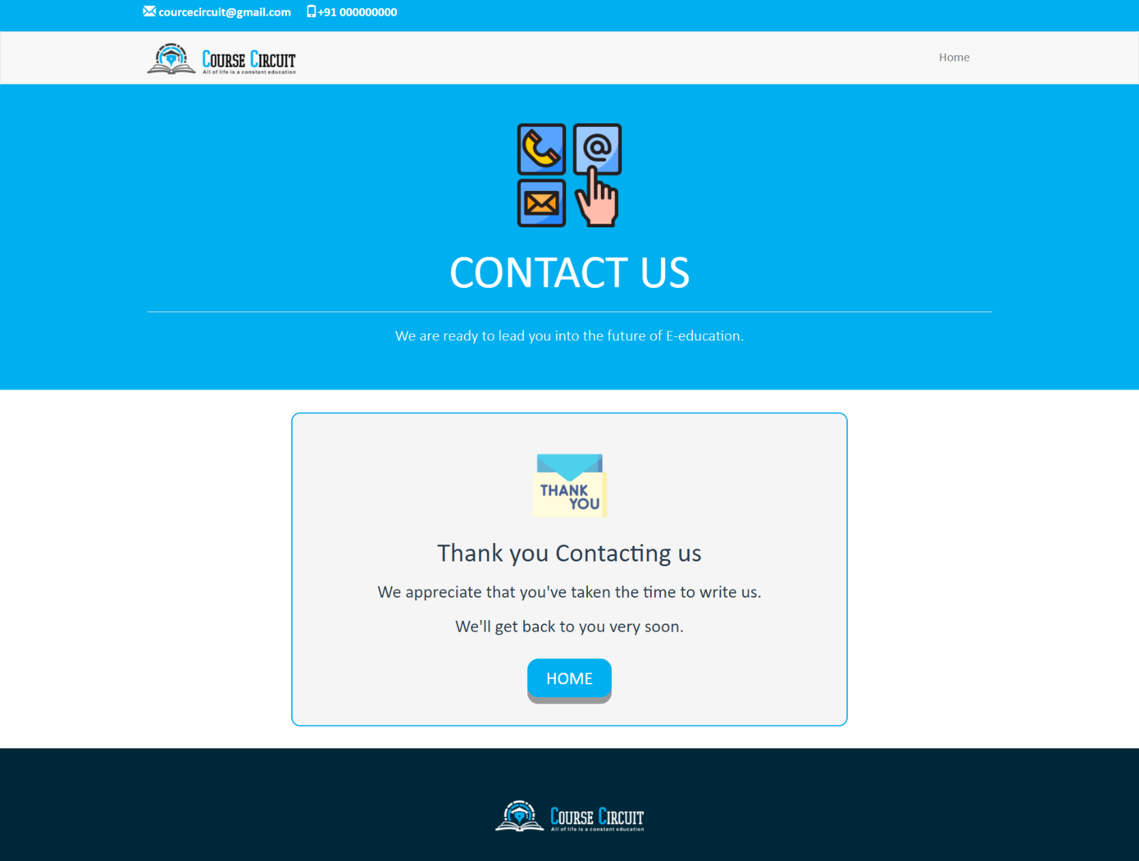
Cont..
Fig.8.2: Contact Us

Slide 39
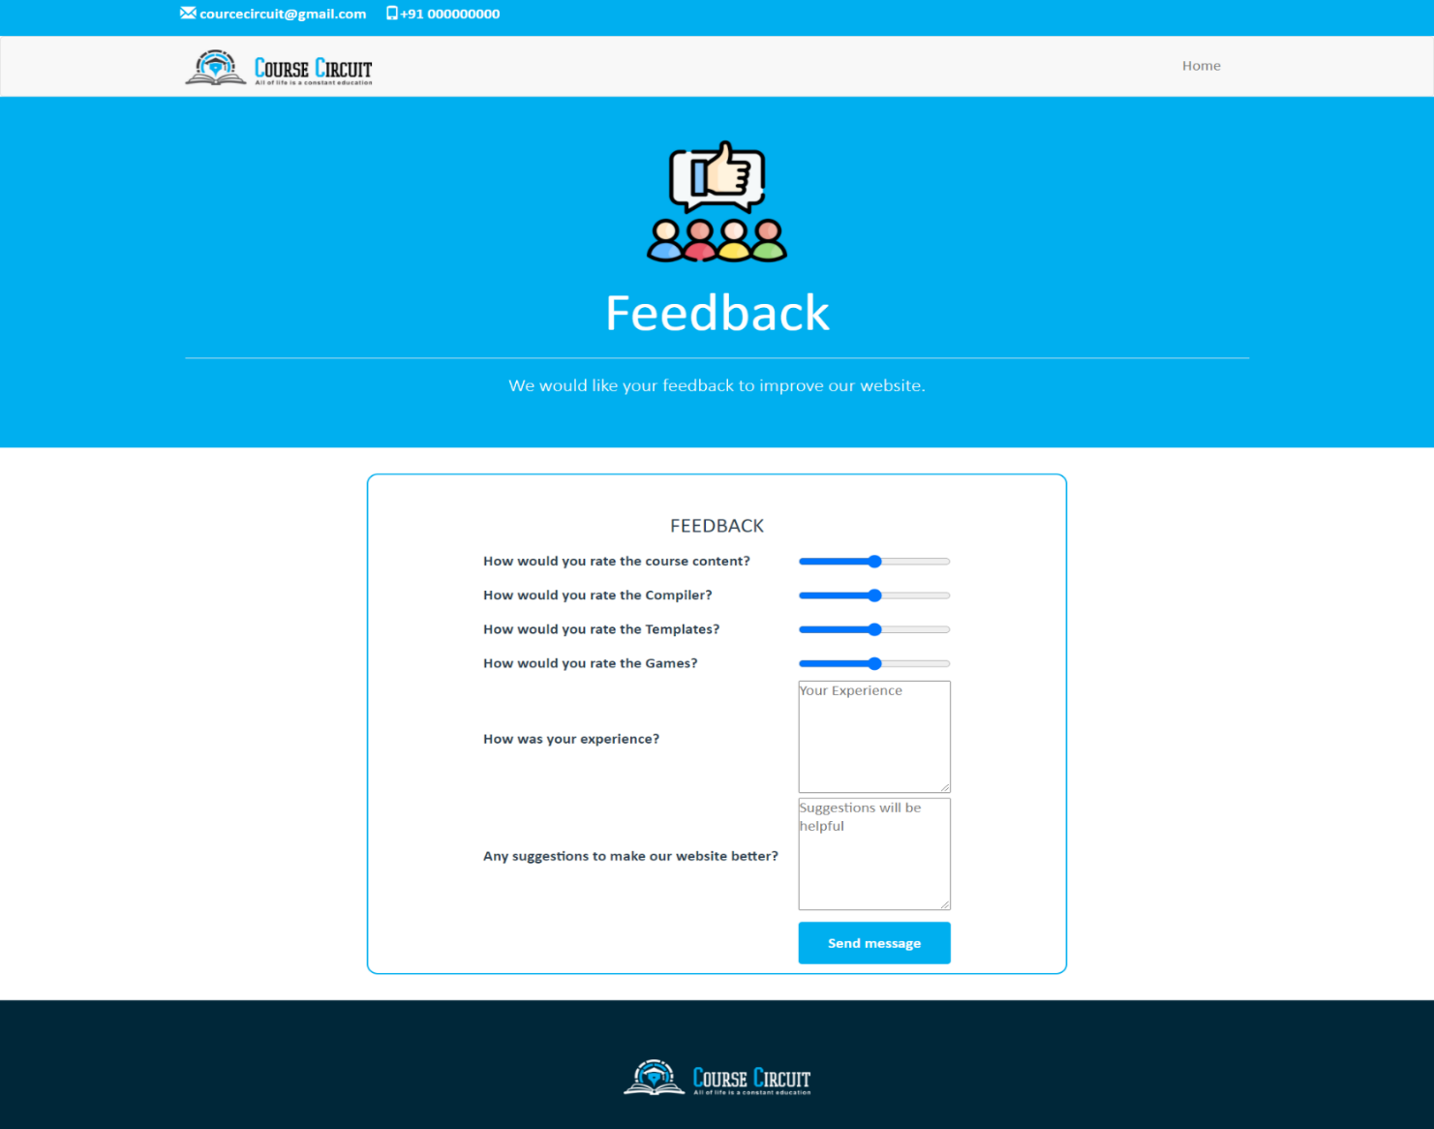
Cont..
Fig.9.1: Feedback

Slide 40
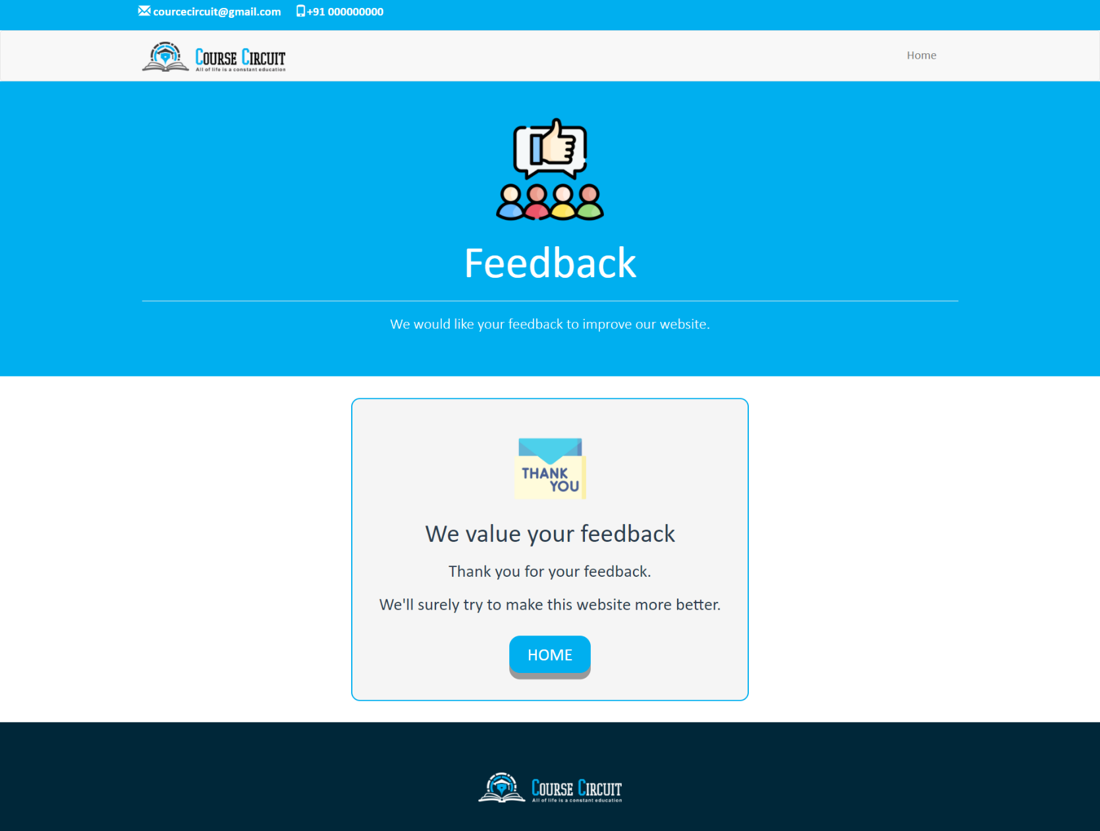
Cont..
Fig.9.2: Feedback

Slide 41
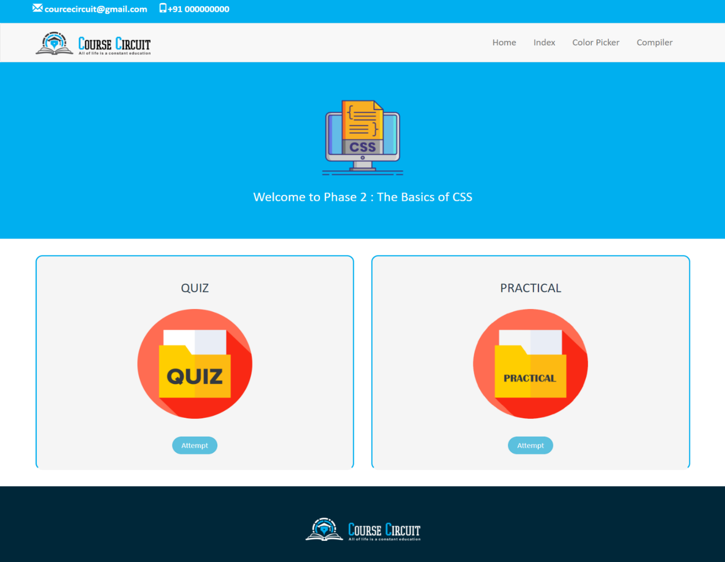
Cont..
Fig.10: Quiz & Practical

Slide 42
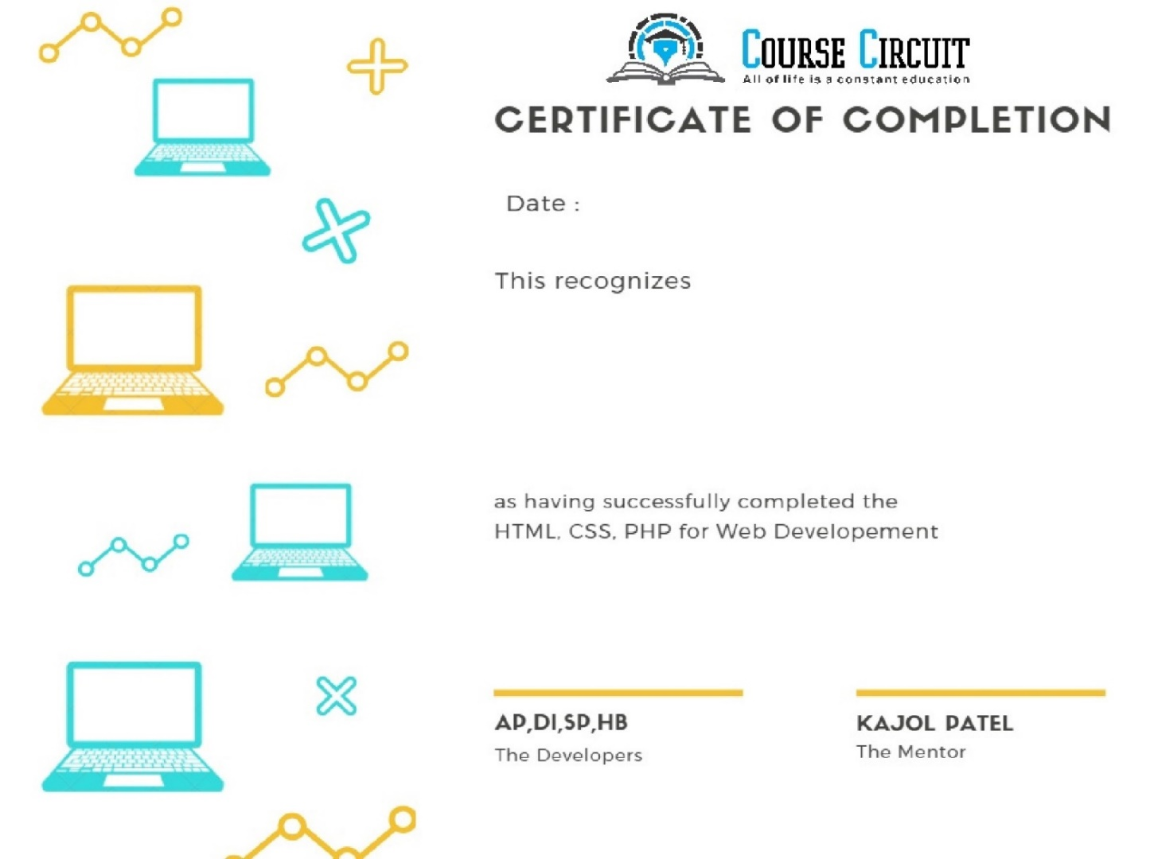
Cont..
Fig.11: Certificate

Slide 43
Conclusion
We are going to develop an E-learning website for students where They can learn how website is developed and hosted
We also help them with online compilers so that they could learn things easily without installing high software’s, our courses are certified courses so we will provide certificate after the completion of course.

Slide 44
Future Scope
More courses
Student peer grading system
Application platform
cloud database
multiple Languages Compliers

Slide 45
Bibliography
https://www.w3schools.com/
https://www.hostgator.in/
https://www.coursera.org/

Slide 46
Thank You

